Slide 1
Digital Portfolio
STUDENT NAME: S HARIHARAN
REGISTER NO AND NMID:autunm1455unmcsa06
DEPARTMENT: BSC(COMPUTER SCIENCE)
COLLEGE: TAGORE COLLEGE OF ARTS AND SCIENCE,
CHROMPET/UNIVERSITY OF MADRAS

Slide 2
PROJECT TITLE
DIGITAL PORTFOLIO
For Student

Slide 3


AGENDA
Problem Statement
Project Overview
End Users
Tools and Technologies
Portfolio design and Layout
Features and Functionality
Results and Screenshots
Conclusion
Github Link
3/21/2024 Annual Review

Slide 4

PROBLEM STATEMENT
»In today’s digital world, having only a traditional resume is not enough to stand out. »Recruiters and peers often prefer interactive, easily accessible portfolios instead of static documents. »The challenge was to design and build a personal portfolio website that is simple, professional, and responsive, while also highlighting my personality as an aspiring developer.

Slide 5

PROJECT OVERVIEW
Brief Summary of the Project: This is a personal digital portfolio website designed to showcase my skills, projects, and achievements. The portfolio is fully responsive, visually engaging, and serves as a professional introduction to who I am as an aspiring developer.

Slide 6
Sections Included: Home → A welcoming hero section with introduction and CV access. About Me → A short background about my passion, learning, and career goals. Skills → Highlights of my core soft and technical skills. Projects (Portfolio) → A gallery of my completed and ongoing projects, with interactive image previews. Contact → Direct links to my email, LinkedIn, and GitHub for networking.

Slide 7
Main Idea:
The portfolio’s main purpose is to provide a central hub where recruiters, peers, and collaborators can easily explore my background, skills, and work. It reflects my personality and showcases my ability to build modern, responsive, and interactive websites.

Slide 8

WHO ARE THE END USERS?
▶Recruiters : to evaluate skills & projects.
▶Professors / College evaluators : academic review.
▶Peers and collaborators
▶Self-branding : personal growth, online presence.

Slide 9

TOOLS AND TECHNIQUES
HTML → Used to structure the content of the website (sections like Home, About, Projects, Contact). CSS → Styled the portfolio with colors, layouts, animations, and responsive design for mobile and desktop. JavaScript → Added interactivity such as scroll animations, project image viewer, and smooth user experience. ACode App → A mobile code editor where the entire project was built and tested.

Slide 10
POTFOLIO DESIGN AND LAYOUT
Dark Theme → The portfolio uses a dark navy background with light text, creating a modern and professional look. Bright cyan highlights are used to make important elements like headings and buttons stand out. Organized Sections → The site is divided into clear sections (Home, About, Skills, Projects, Contact), making navigation simple and user-friendly. Responsive Layout → The design adapts to any screen size. On mobile, sections stack vertically, while on larger screens, the layout uses flexible grids and spacing.
10

Slide 11
Hero Section → Includes a welcome message, personal introduction, and profile picture with a glowing effect. It also provides quick access to view or download the CV. Projects Grid → Projects are displayed in card-style boxes with hover effects. Clicking on a project opens an interactive image viewer for more details. Contact Area → Shows email, phone, LinkedIn, and GitHub in a clean, centered design, making it easy for others to connect.

Slide 12
FEATURES AND FUNCTIONALITY
Animated Section Reveal → Each section smoothly fades in as the user scrolls down, making the site engaging. Interactive Image Viewer → Clicking on a project opens a full-screen image viewer with next/previous buttons for browsing. Responsive Design → Works seamlessly on desktops, tablets, and smartphones. Layout automatically adjusts to screen size.

Slide 13
Downloadable CV → Visitors can either view the CV directly on the site or download it for later. Hover Effects → Buttons and project cards have hover animations, making the site more interactive and modern. Smooth Scrolling → Navigation between sections feels natural and user-friendly.

Slide 14
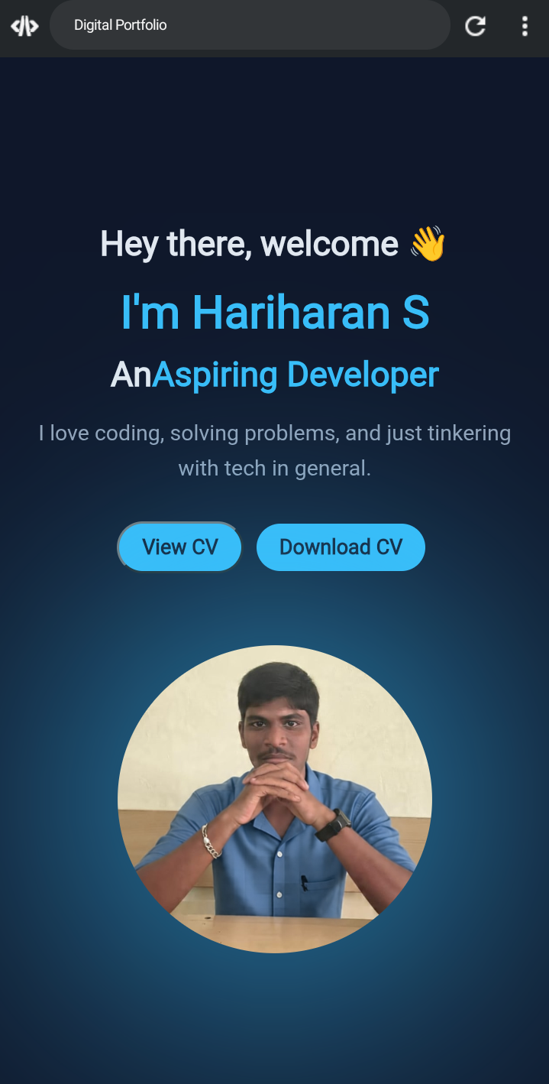
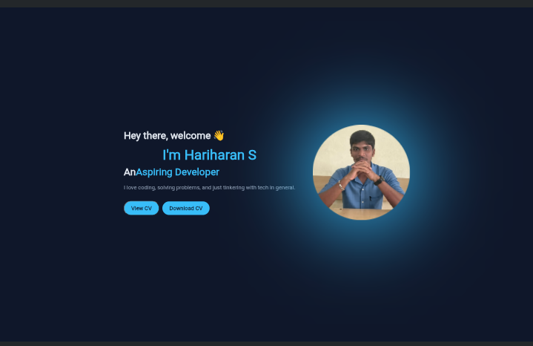

RESULTS AND SCREENSHOTS
3/21/2024 Annual Review
14

Slide 15
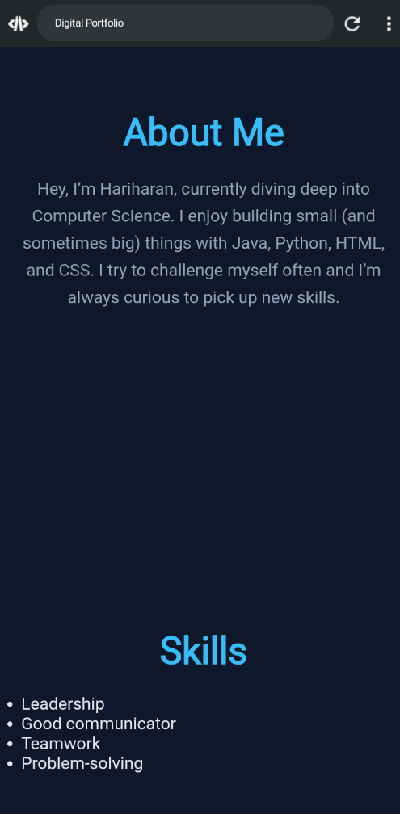
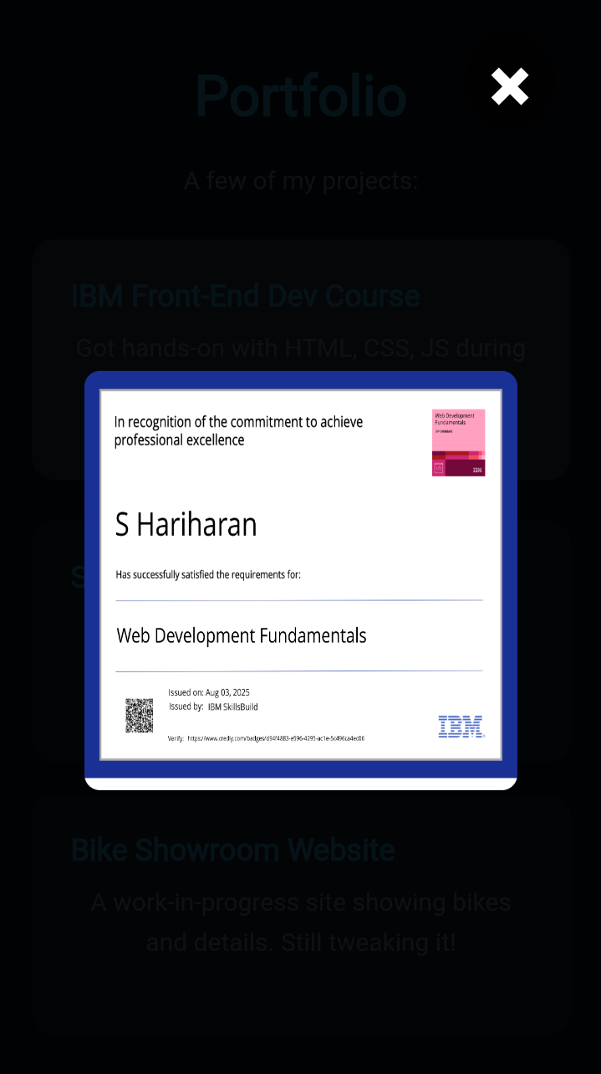
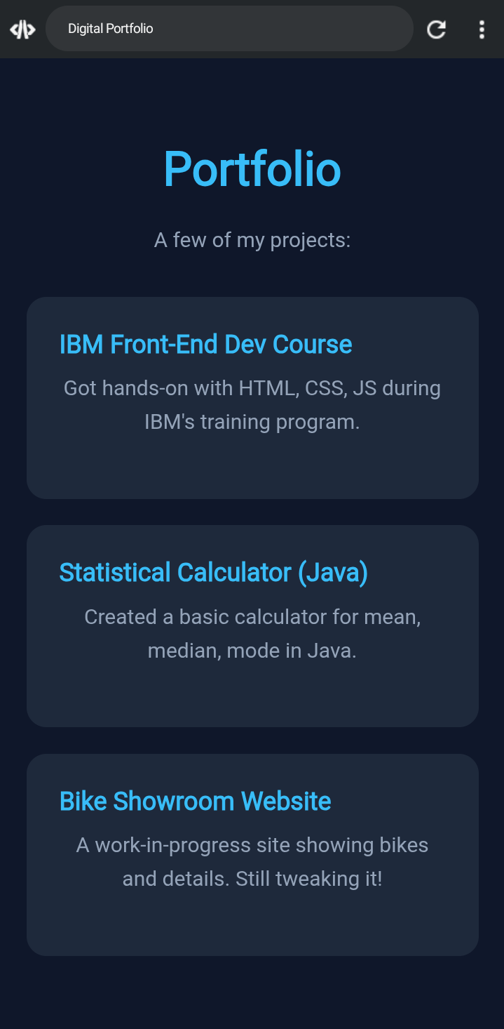

Slide 16
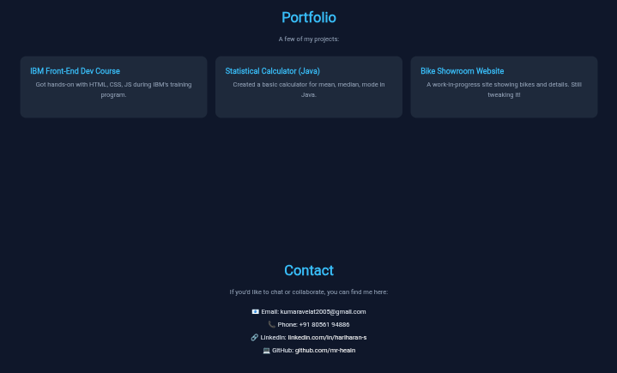

Slide 17
CONCLUSION
Highlights of the Project »Built a personal portfolio website from scratch using HTML, CSS, and JavaScript. »Designed with a modern dark theme and responsive layout. »Added interactive features like scroll animations, image viewer, and hover effects. »Showcases projects, skills, and achievements in a structured way. Final Summary This portfolio is more than just a website – it’s a digital identity. It reflects my passion for coding, my ability to design user-friendly layouts, and my drive to continuously learn and grow as a developer.
17

